Slide 1
Agentic AI Hackathon: Building Intelligent Agents with
IBM Granite and LangFlow

Slide 2



Name of the team: SIGNAL
Name | Photo | Email ID | Phone no.
Shashank Shantharam Nayak |  | shashankshantharam.cs23@bmsce.ac.in | 9880242341
Pranay Kommuri |  | pranaykumar.cs23@bmsce.ac.in | 8431470260
Saketha Ram |  | kollusaketha.cs23@bmsce.ac.in | 7569594295

Slide 3
PROBLEM STATEMENT
AI-Driven Early Warning System for Traffic Congestion Hotspots
Traffic management is becoming increasingly complex, as cities and commuters struggle with:
Reactive congestion detection – traffic issues are identified only after congestion has already formed.
Fragmented data sources – traffic information spread across sensors, GPS systems, cameras, and weather data.
Lack of predictive insights – limited ability to anticipate congestion hotspots before they occur.
Ineffective alerts – delayed or generic traffic updates that do not support timely decision-making.
Without a reliable, intelligent assistant, travelers spend excessive time researching and still end up making suboptimal choices, leading to poor travel experiences, overspending, or missed opportunities.

Slide 4
PROPOSED SOLUTION
Key solution components include:
Data ingestion agents – powered by Watsonx, continuously collecting and normalizing data from traffic sensors, GPS feeds, weather systems, and incident reports.
Reasoning and prediction agents – Watsonx LMs analyze patterns, correlate multi-source data, and forecast congestion risks and emerging hotspots.
Decision orchestration agents – evaluate predicted scenarios and recommend optimal traffic control actions such as rerouting or signal optimization.
Alert and communication agents – generate clear, contextual, and timely warnings for traffic authorities and commuters.
By using Watsonx LM agentic AI, the system shifts traffic management from reactive monitoring to proactive, intelligent orchestration—reducing congestion duration, improving travel efficiency, lowering emissions, and enhancing overall urban mobility.

Slide 5
NEED OF PROJECT
Urban traffic congestion is increasingly unpredictable and causes longer travel times and commuter frustration.
Existing traffic systems are reactive and fragmented, limiting timely interventions.
Congestion leads to higher fuel consumption, emissions, and economic losses.
There is a need for a proactive, intelligent system that predicts congestion hotspots in advance.
Watsonx LM agentic AI can provide real-time reasoning, early warnings, and coordinated traffic management to improve urban mobility.

Slide 6
END USER OF PROJECT
Traffic authorities & control rooms – monitor hotspots early and optimize signals/rerouting
Traffic police & incident teams – respond faster with diversions and enforcement
Commuters/public – get early warnings and choose better routes/times
Transport & mobility operators (bus/metro/ride-hailing/logistics) – improve ETAs, dispatch, and routing
Urban planners/policymakers – analyze trends for long-term infrastructure decisions

Slide 7
TECHNOLOGY USED
Langflow platform
Langflow component names – Chat Input, Language Model, CSV Agent, Traffic Analysis (Agent), Chat Output, Astra DB CQL (Tool)
IBM Granite model – ibm/granite-3-3-8b-instruct (as shown in your flow)
IBM Cloud (watsonx hosted endpoint + project setup)
IBM watsonx.ai (Model provider for inference)
Watsonx (Watsonx ecosystem: LLM + tools integration)
RAG (Retrieval Augmented Generation) – Used via CSV dataset retrieval (CSV Agent) + optional Astra DB retrieval (if connected)

Slide 8
NOVELTY AND UNIQUENESS
Proactive instead of reactive: Predicts congestion hotspots before they form, not after traffic builds up.
Agentic AI orchestration: Multiple Watsonx agents don’t just analyze data—they coordinate decisions like rerouting and signal optimization.
Multi-source intelligence fusion: Combines traffic sensors, GPS feeds, weather, and incident reports into one unified reasoning layer.
Context-aware alerts: Generates clear, actionable warnings tailored for both authorities and commuters (not generic updates).
Continuous learning: Improves forecasts over time by learning recurring congestion patterns and sudden disruption signals.
End-to-end automation: From data ingestion → prediction → decision recommendation → alert delivery, all in one pipeline.

Slide 9
ARCHITECTURE BLUEPRINT
Proactive instead of reactive: Predicts congestion hotspots before they form, not after traffic builds up.
Agentic AI orchestration: Multiple Watsonx agents don’t just analyze data—they coordinate decisions like rerouting and signal optimization.
Multi-source intelligence fusion: Combines traffic sensors, GPS feeds, weather, and incident reports into one unified reasoning layer.
Context-aware alerts: Generates clear, actionable warnings tailored for both authorities and commuters (not generic updates).
Continuous learning: Improves forecasts over time by learning recurring congestion patterns and sudden disruption signals.
End-to-end automation: From data ingestion → prediction → decision recommendation → alert delivery, all in one pipeline.

Slide 10
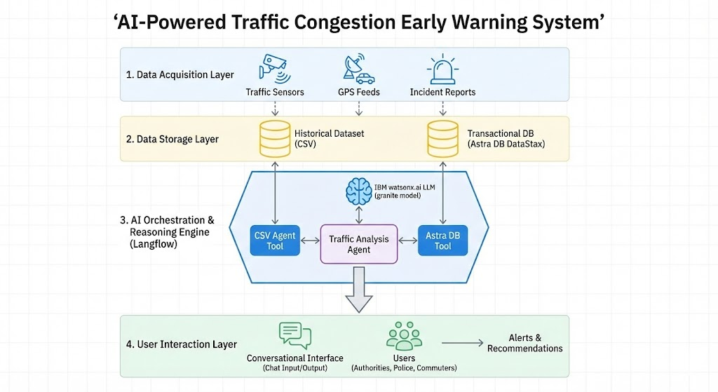
TECHNICAL FLOW DIAGRAM

Slide 11
LANGFLOW COMPONENTS
1. Chat Input
    Takes user query as input
    Starts the flow
    Example: “Traffic in Koramangala at 9 PM?”
2. IBM watsonx AI Agent
  Main AI brain of the system
  Understands location + time from query
  Predicts congestion/hotspots
  Suggests actions (reroute / signal control)
3. File Component
  Uploads traffic dataset (CSV)
  Provides historical data for prediction
  Helps improve accuracy

Slide 12
LANGFLOW COMPONENTS (contd.)
Chat Output
  Shows final answer to the user
  Gives warnings + predictions clearly
Prompt / System Prompt
  Defines agent role and rules
  Makes output clear and consistent
CSV Loader / Parser
  Reads CSV properly into usable format
  Extracts columns like Date, Area, Traffic
Memory (Optional)
  Remembers chat context
  Helps follow-up questions

Slide 13
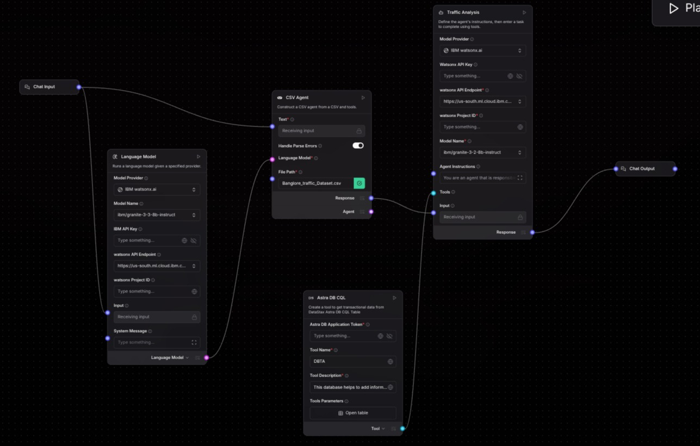
LANGFLOW NETWORK

Slide 14
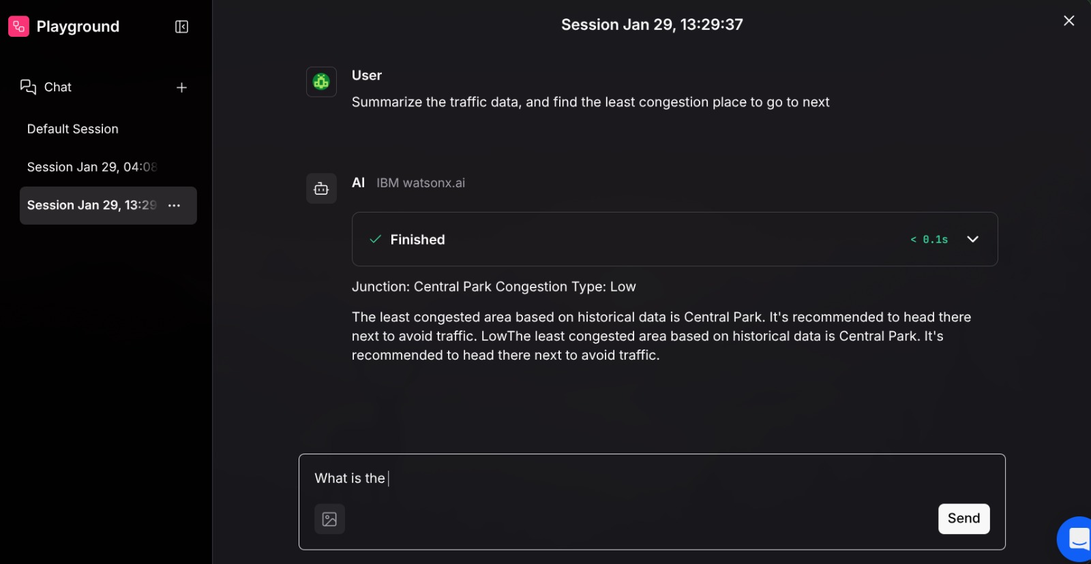
CHAT PROMPT 1

Slide 15
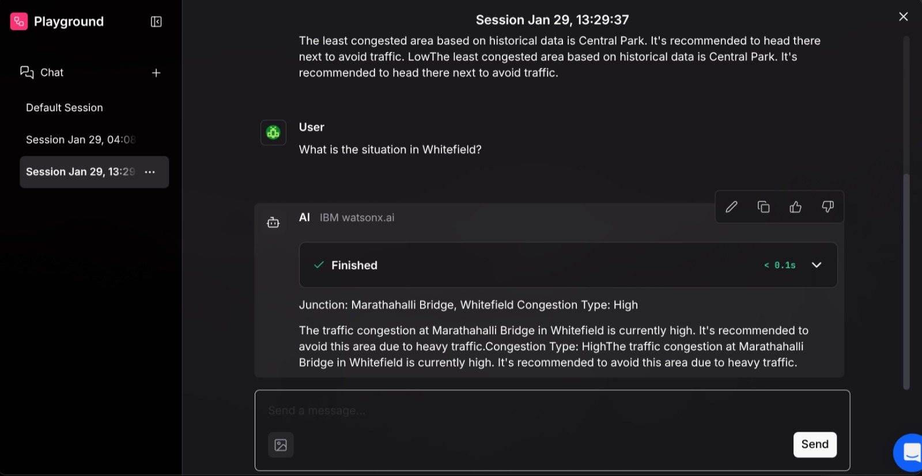
CHAT PROMPT 2

Slide 16
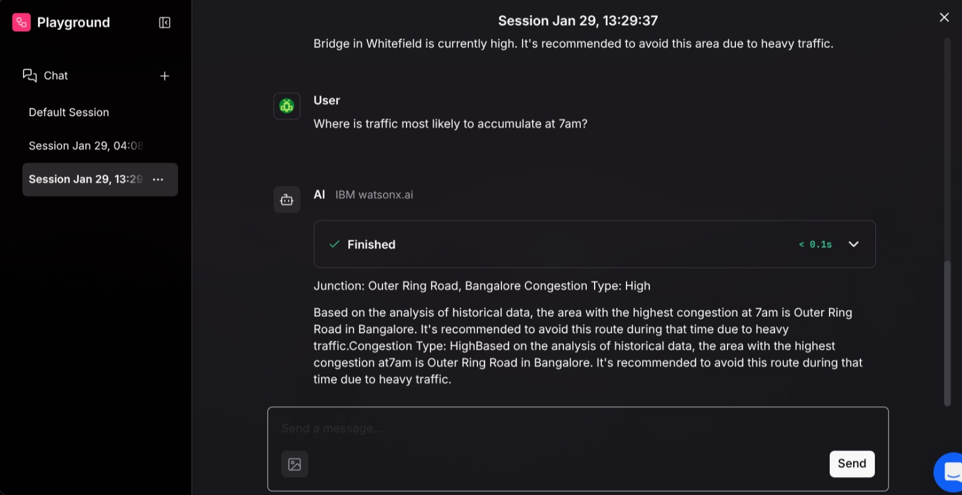
CHAT PROMPT 3

Slide 17
FUTURE SCOPE
Integration with adaptive traffic signals: Automatically change signal timings in real-time based on predicted congestion.
AI-driven route recommendations: Provide personalized alternate routes for commuters and fleets.
Incident detection + response automation: Detect accidents/breakdowns early and trigger emergency/diversion workflows.
Multi-city scalability: Expand the system to support multiple cities with region-specific traffic patterns.
Public transport optimization: Predict bus delays, improve scheduling, and suggest dynamic route adjustments.

Slide 18
FUTURE SCOPE (contd.)
Event-based congestion control: Forecast traffic surges during festivals, concerts, sports events, or peak hours.
Smart parking guidance: Predict parking demand and guide vehicles to available parking to reduce road clogging.
Environment & sustainability insights: Track emission reduction and fuel savings from congestion prevention.
V2X readiness: Future integration with connected vehicles (vehicle-to-infrastructure communication).

Slide 19
GITHUB LINK
https://github.com/DevelSSN/ibm-hackathon-project
Notes:
· Please create public github repository (Enable Add README button while creating repository) with format –
Please test and Paste the working Github URL –
Make sure you have Uploaded following three files into your github repository
1) app.py file , 2) your_hackthon_problemstatement.pdf file 3) your projectpresntation.pptx file

Slide 20
References
Langflow docs - https://docs.datastax.com/en/langflow/index.html
Langchain docs - https://docs.langchain.com/

Slide 21


